Slide 1


Blood Cell Image Classification Using Neural Networks
Brian Martinez
Ian Marquez

Slide 2

Outline
Introduction
Understanding the Problem
Data and Data Processing
Machine Learning Approach
Results and Analysis
Discussion and Future Work

Slide 3
Introduction

Slide 4
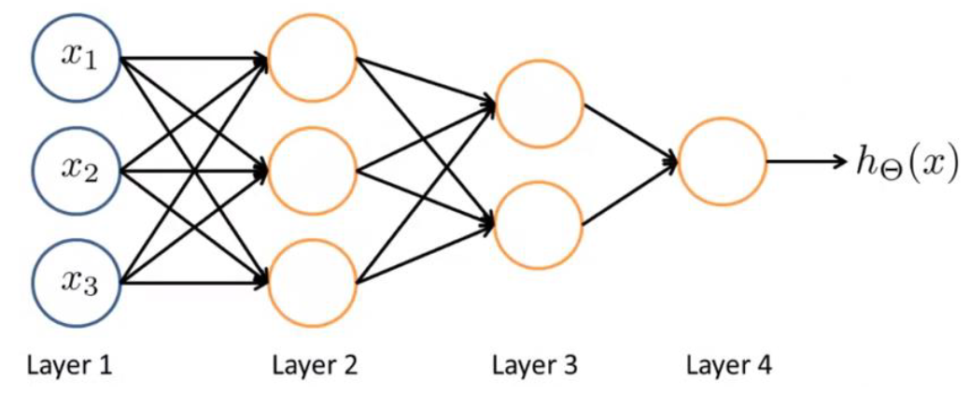
Introduction
A Neural Network(NN) is a machine learning technique reminiscent of biological neural networks
NNs are comprised of nodes called neurons, each with the ability to transmit signals to one another
Each NN has layers of neurons
Neural Network Example

Slide 5
Understanding the Problem

Slide 6
Understanding the Problem
Over 250,000 clinical labs in the US
13 billion lab tests annually
7 billion clinical test annually
Estimated 251,000 deaths annually due to medical error (2016)
Third leading cause of death after heart disease and cancer
Many processes are still manual in heathcare
Machine Learning can be used to help mitigate errors, improve workflow, and patient care

Slide 7
Data and Data Processing

Slide 8
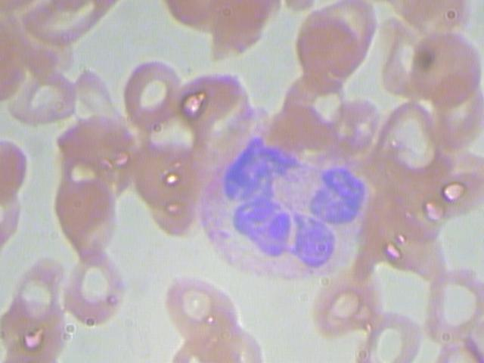
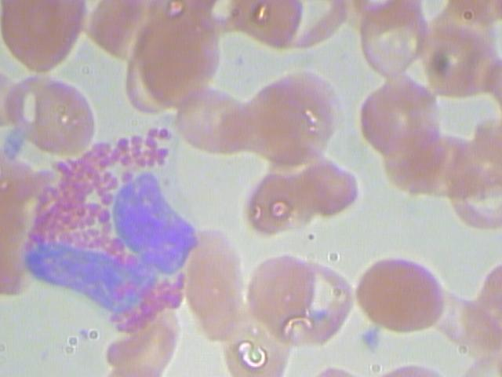
Data and Data Processing
Data Consists of 12,910 blood images
410 original and 12,500 augmented
First need to process images to identify the red blood cells
Neutrophil
Eosinophil

Slide 9
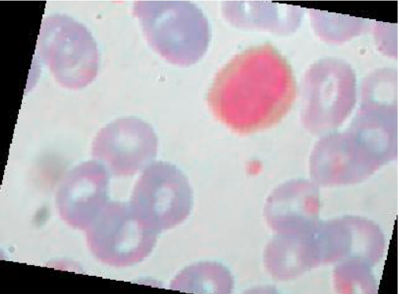
Data and Data Processing-
Preprocessing
ImageDataGenerator()
Dimensionality Reduction
Image Manipulation
RGB Array Construction
Reduction of processing time
Epoch Length ~= 23sec -> Epoch Length ~=9 Sec

Slide 10
Machine Learning Approach

Slide 11
Machine Learning Approach
Use Neural Network to accurately determine blood cell types

Slide 12
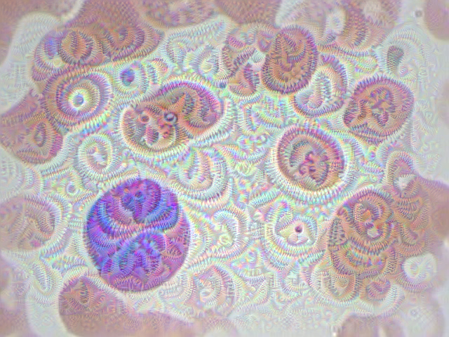
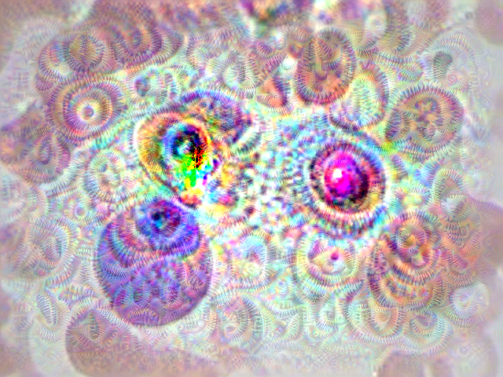

Machine Learning Approach-
Pitfalls
Use Neural Network effectively to accurately determine blood cell types
-20 Iterations
-Conservative Ascending Gradient
50 Iterations
-High loss
-Artifacts generated
120 Iterations
-Artifact Persistent
-Destructive interference

Slide 13




Machine Learning Approach – Trade Study

Slide 14
Machine Learning Approach – Trade Study
More Support for NVIDIA GPUs
Keras allowed for high level development and implementation
Linux and Windows 10 compatible libraries

Slide 15




Machine Learning Approach – Development Rig
NVIDA T1070 GPU
32 Gb RAM
Ubuntu 17.10
Anaconda Environment
Keras Development Library
Tensor Flow
NVIDA CUDA Toolkit
NVIDA cuDNN

Slide 16
NN Architecture
2D Convolutional Layer
3x3 filters
Detect ReLU activation

Slide 17
NN Architecture
2D Convolutional Layer
2x2 Pool size, border detection
Max Pooling (Spatial)

Slide 18
NN Architecture
2D Convolutional Layer
0.25 rate of Zeroing inputs Prevent Overfitting
Max Pooling (Spatial)
Dropout

Slide 19
NN Architecture
2D Convolutional Layer
Reduce input
N x 1
Max Pooling (Spatial)
Dropout
Flatten

Slide 20
NN Architecture
2D Convolutional Layer
0.5 rate of Zeroing inputs Prevent Overfitting
Max Pooling (Spatial)
Dropout
Flatten
Dropout

Slide 21
NN Architecture
2D Convolutional Layer
Output dimensionality=
#classes
Max Pooling (Spatial)
Dropout
Flatten
Dropout
Dense

Slide 22
Results and Analysis

Slide 23
Results and Analysis
Five models generated: Base, Alpha, Beta, and Gamma
Images used for each model were manipulated in one or more ways:
Random Horizontal Flip
Random vertical Flip
Random degree of rotation from 0º to 180º
Random height shift
Random width shift
2D Convolutional Layer Addition

Slide 24
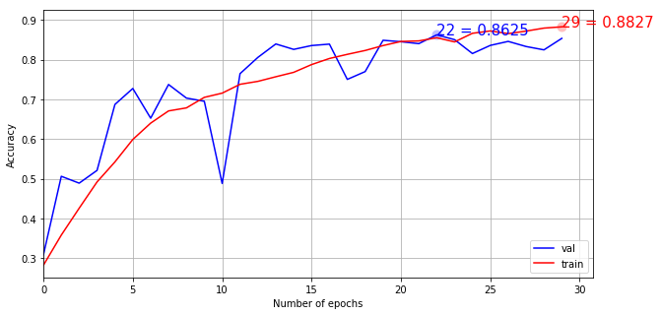
Results and Analysis-Base
Mods used: Random horizontal flip, 10º rotation, 0.1 width and height shift range
 | Precision | Recall | F1-score | Support
NEUTROPHIL | 0.74 | 0.75 | 0.74 | 624
EOSINOPHIL | 0.71 | 0.86 | 0.78 | 623
MONOCYTE | 0.98 | 0.75 | 0.85 | 620
LYMPHOCYTE | 1 | 1 | 1 | 620
Avg / Total | 0.86 | 0.84 | 0.84 | 2487
Large dip in model accuracy before midpoint

Slide 25
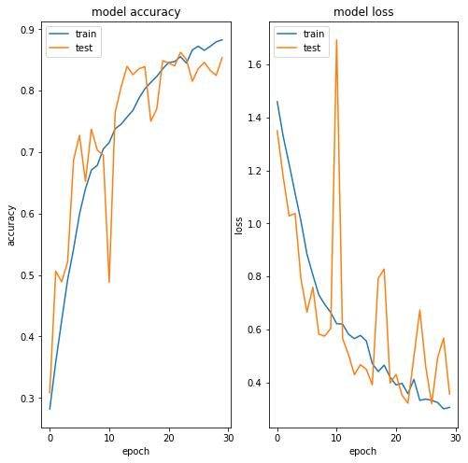
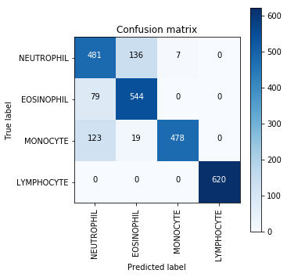
Results and Analysis-Base
364 errors or 85.36% accuracy
Highest accuracy with Lymphocyte detection, lowest with momocyte

Slide 26
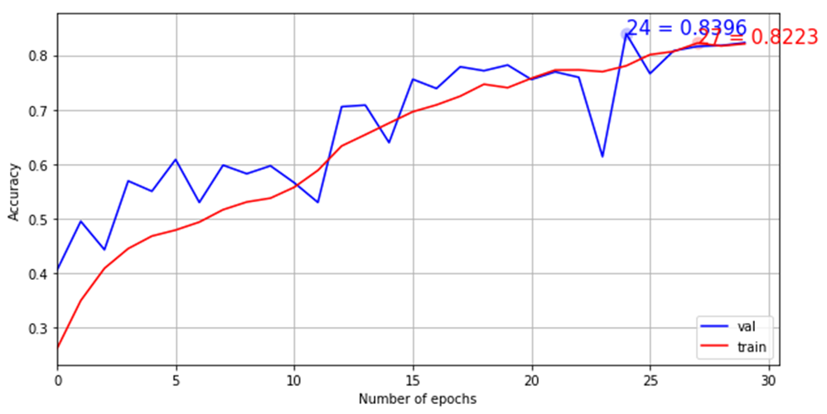
Results and Analysis-Alpha
Mods used: Random horizontal flip, random vertical flip, 70º rotation, 0.1 width and height shift range
 | Precision | Recall | F1-score | Support
NEUTROPHIL | 0.63 | 0.74 | 0.68 | 624
EOSINOPHIL | 0.77 | 0.81 | 0.79 | 623
MONOCYTE | 0.99 | 0.75 | 0.85 | 620
LYMPHOCYTE | 0.98 | 1 | 0.99 | 620
Avg / Total | 0.84 | 0.82 | 0.83 | 2487
Steady climb in accuracy, training and test data have similar results

Slide 27
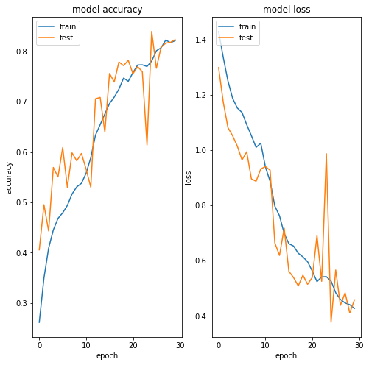
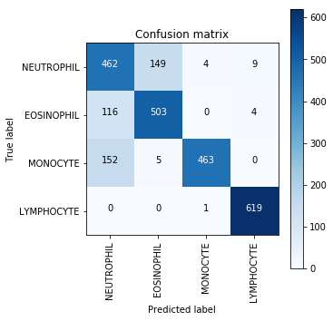
Results and Analysis-Alpha
83.96% testing accuracy
Lymphocyte has highest detection accuracy, while neutrophil and monocyte
detection are similarly low

Slide 28
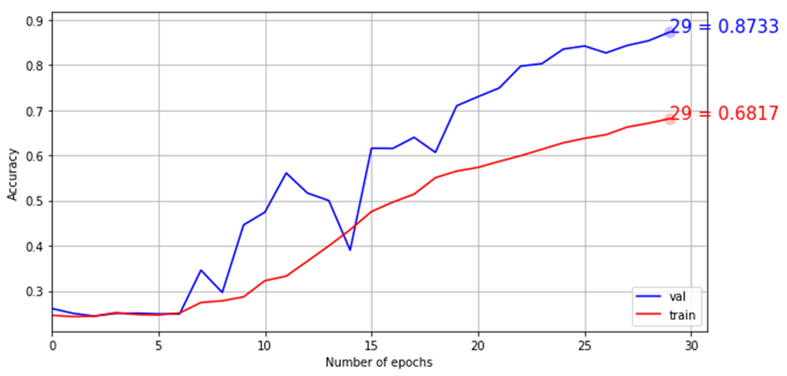
Results and Analysis-Beta
Mods used: Random horizontal flip, random vertical flip, 70º rotation, 0.5 width and height shift range
 | Precision | Recall | F1-score | Support
NEUTROPHIL | 0.72 | 0.82 | 0.77 | 624
EOSINOPHIL | 0.85 | 0.95 | 0.89 | 623
MONOCYTE | 0.98 | 0.75 | 0.85 | 620
LYMPHOCYTE | 0.99 | 1 | 0.99 | 620
Avg / Total | 0.89 | 0.87 | 0.87 | 2487
Low trial accuracy but high test accuracy

Slide 29
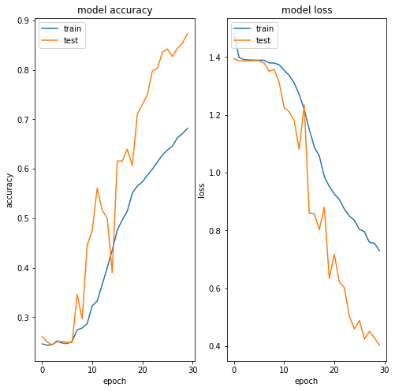
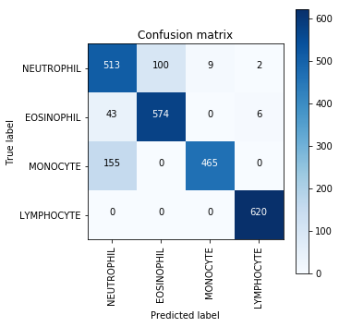
Results and Analysis-Beta
87.33% overall accuracy, all but monocyte detections reasonably accurate

Slide 30
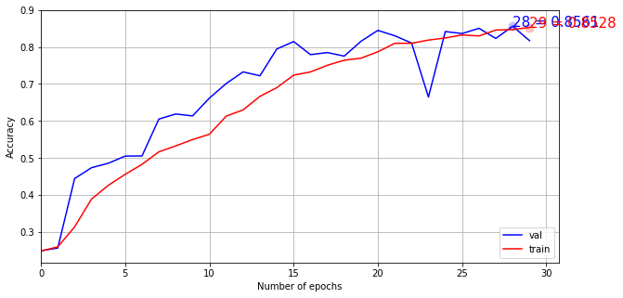
Results and Analysis-Gamma
Mods used: Random horizontal flip, random vertical flip, 180º rotation, 0.1 width and height shift range
 | Precision | Recall | F1-score | Support
NEUTROPHIL | 0.70 | 0.71 | 0.71 | 624
EOSINOPHIL | 0.75 | 0.82 | 0.79 | 623
MONOCYTE | 0.95 | 0.75 | 0.84 | 620
LYMPHOCYTE | 0.90 | .99 | 0.94 | 620
Avg / Total | 0.82 | 0.82 | 0.82 | 2487
Both trial and testing have similar accuracies

Slide 31
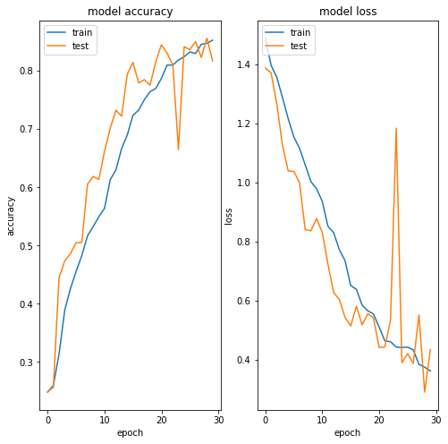
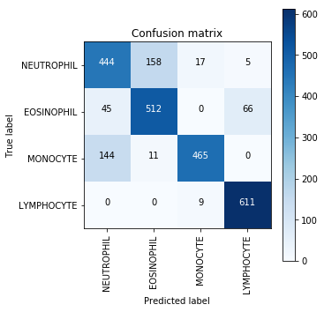
Results and Analysis-Gamma
85.61% accuracy overall neutrophil and monocyte detection lowest

Slide 32
Discussion and Future Work

Slide 33
Discussion and Future Work
Determine why lymphocyte accuracy is reliably high while others are not
Apply same methodology to help identify blood diseases, would require access to HIPAA guarded information
Apply models with CNTK and Theano
Expand NN architecture
Apply Caffe to model

Slide 34
Citations
https://github.com/Shenggan/BCCD_Dataset MIT License
https://github.com/keras-team/keras/blob/master/examples/deep_dream.py
Haymond, "scientificamerican," 9 May 2016. [Online]. Available:
https://blogs.scientificamerican.com/guest-blog/what-everyone-should-know-about-lab-tests/.
[Accessed 23 April 2018].
Value of Lab Testing," American Clinical Laboratory Association, January 2018. [Online]. Available:
http://www.acla.com/value-of-lab-testing/. [Accessed 23 April 2018].

